Slide 1
PCL and ICP

Slide 2
Point Cloud Library
A open source library for point cloud processing
Numerous state-of-the art algorithms: filtering, surface reconstruction, segmentation…
Language: C++
It also supports ROS

Slide 3
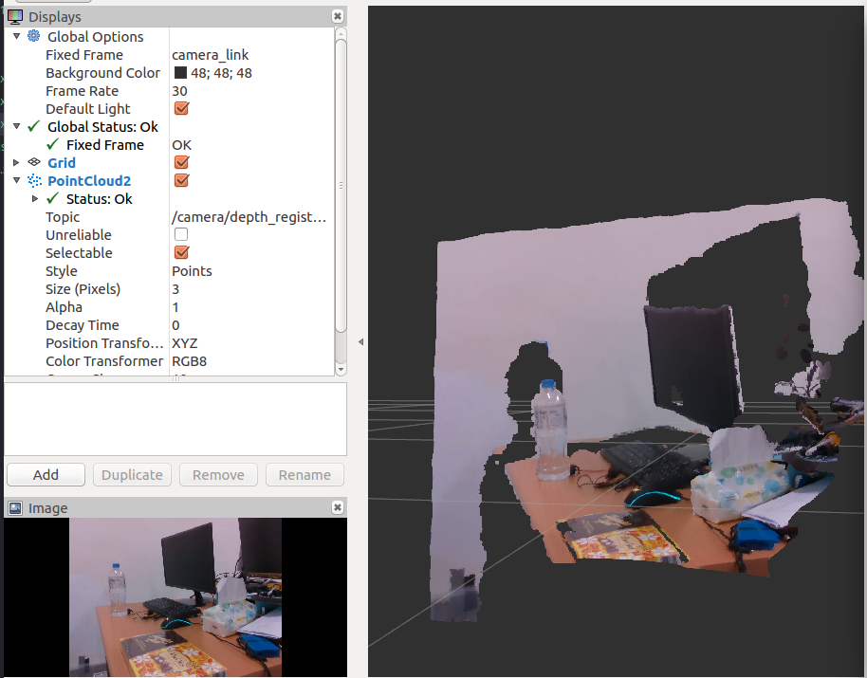
Pointcloud format in PCL
Organized
640*480 points from depth image
pointcloud index = 480*y + x
printf("width: %d\n height: %d\n", cloud->width, cloud->height);
Each point has X, Y, Z, R, G, B values

Slide 4
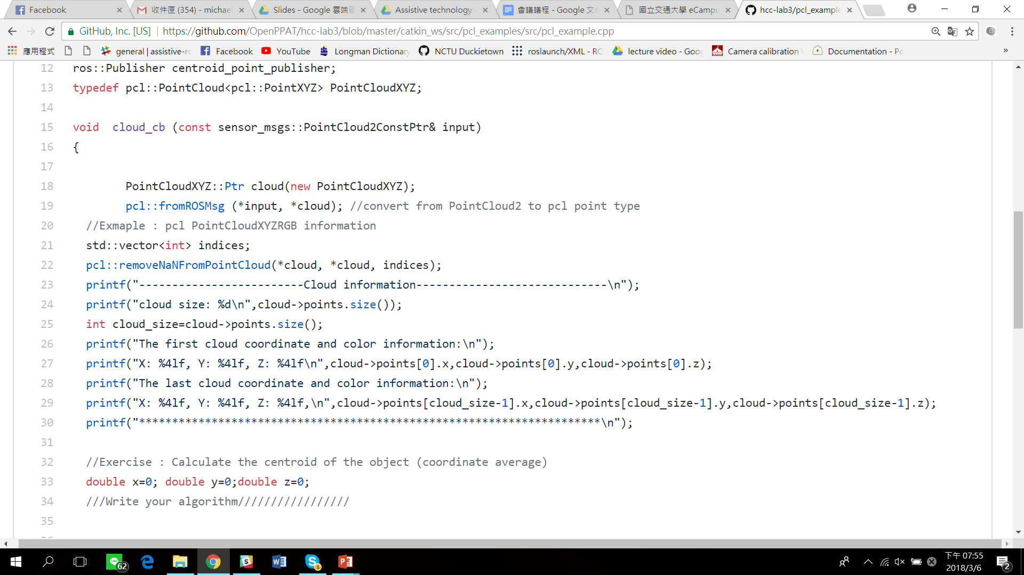
PCL Point type and functions
ROS message to PCL point type
Remove NAN point cloud
Access point cloud value

Slide 5
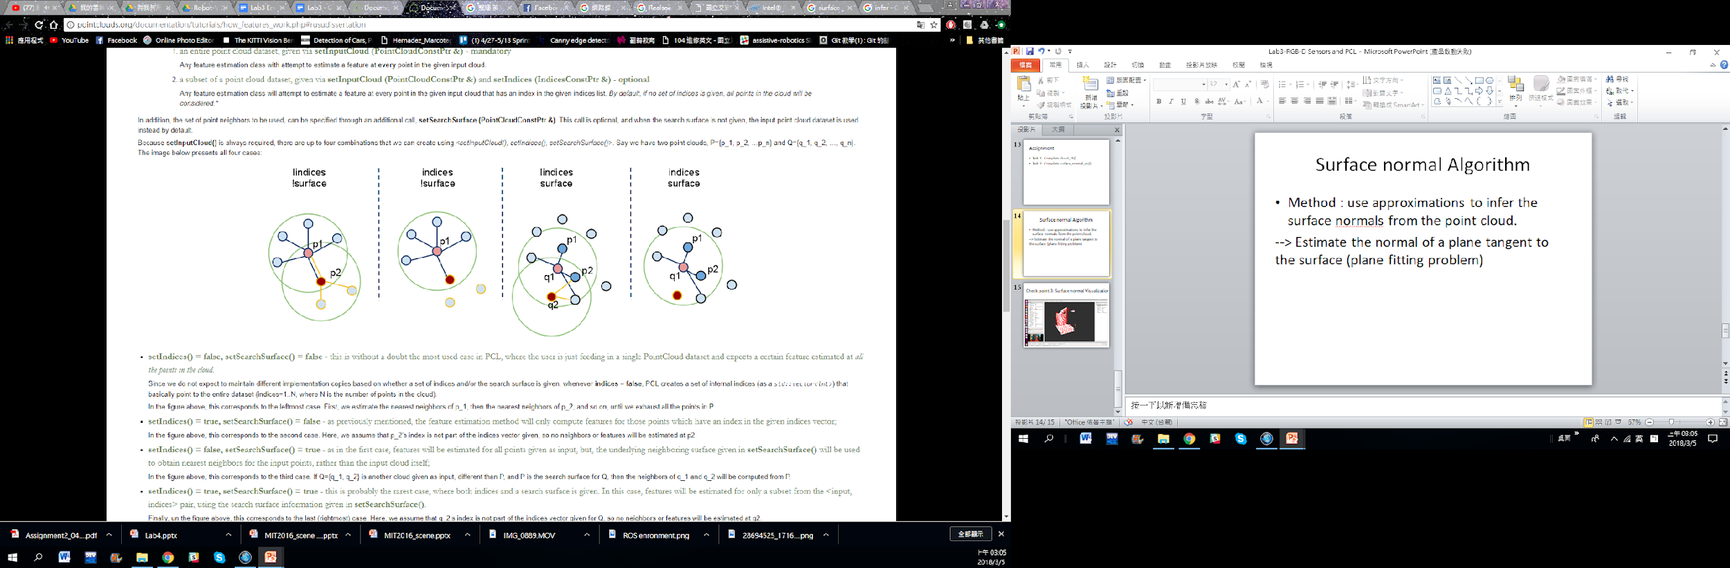
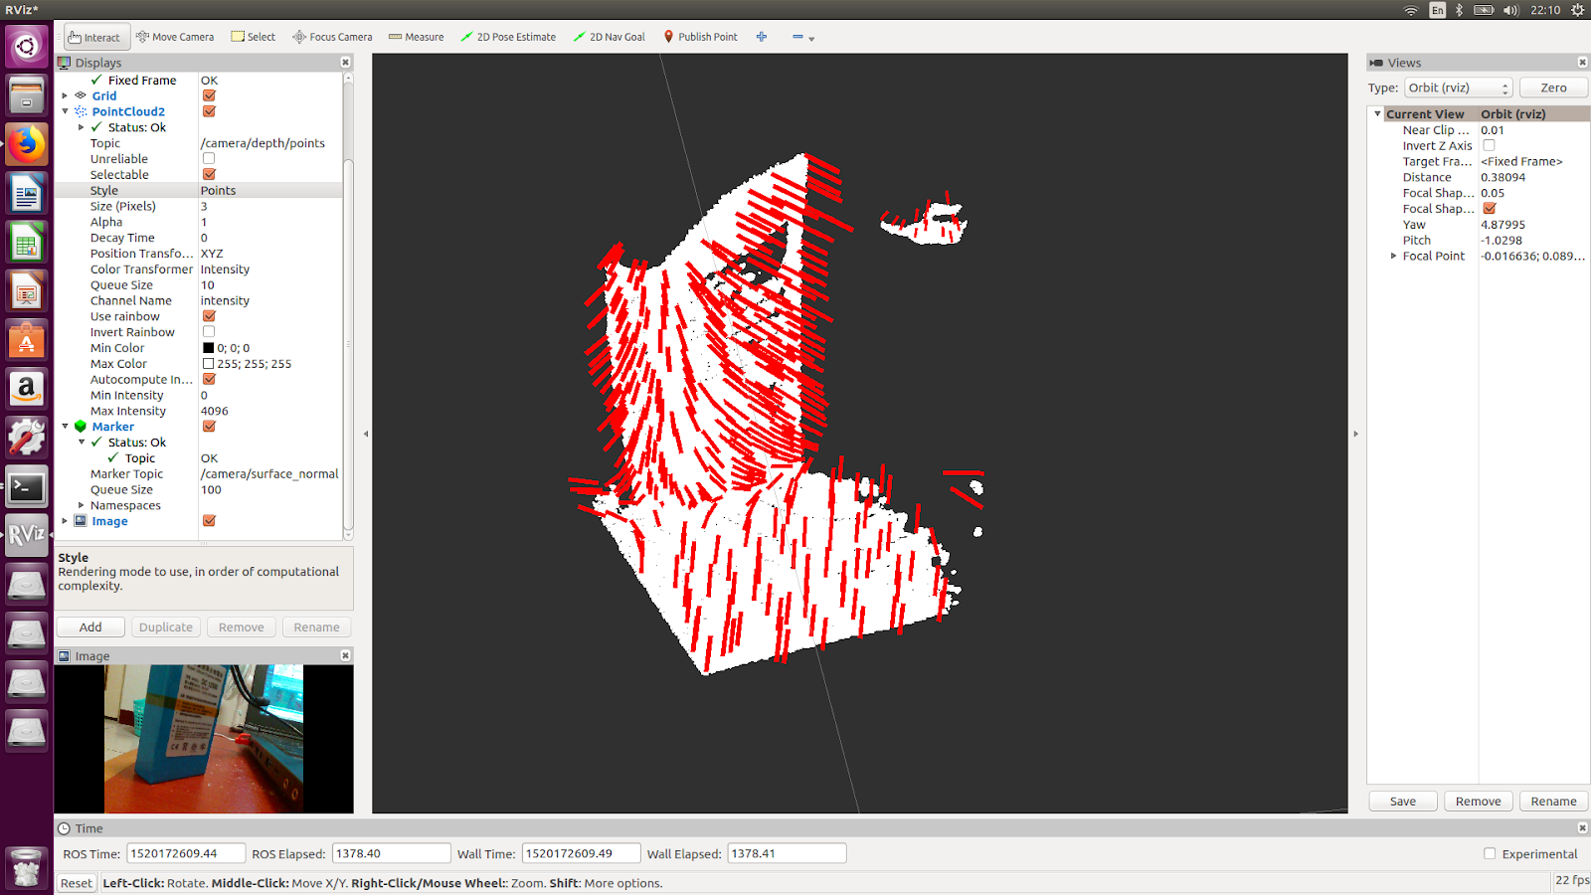

Surface normal Algorithm
Method : use approximations to infer the surface normals from the point cloud.
for each point p in cloud P 1. get the nearest neighbors of p 2. compute the surface normal n of p（compute） 3. check if n is consistently oriented towards the viewpoint and flip otherwise

Slide 6
ICP Algorithm
Preprocess pointcloud
Downsample
Denoise
Start from initial guess
Position: Centroid
Orientation: PCA
ICP
Method
For each point on M, find closet point on P
Find best transform for this corresponding
Transform M
Iter (criterion):
setMaximumIterations, setTransformationEpsilon, setEuclideanFitnessEpsilon
http://www.pointclouds.org/documentation/tutorials/_images/animation.gif

